Slide 1
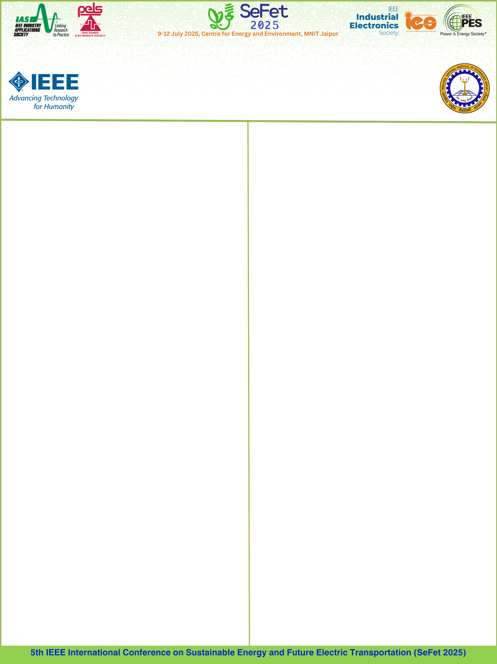
TITLE OF THE PAPER
Name of the Authors
Affiliation
Paper ID: ###
Abstract
Results and Discussion
This is the template for preparation of posters for 2025 IEEE International Conference on Sustainable Energy and Future Electric Transportation (SEFET-2025). Please use this document as a template to form the poster in which you can type your own text. (Font style: Times New Roman, Font size: 32, single-spaced, Font color: Black) and paste figures. For figure titles use, Font style: Times New Roman and Font size: 26.
Introduction
Conclusions
Methodology
References
Use IEEE Referencing style.

